Slide 1

DEPARTMENT OF COMPUTER SCIENCE AND ENGINEERING
GitHub Analytics Pipeline
Fundamentals of Data Engineering
COURSE CODE: 24DEA3101R
Team 10
Satya Austin Abner – 2420030587
Animesh Balaji - 2420030301
Navaneeth - 2420030306
Notes:
Welcome to the GitHub Analytics Pipeline project presentation. This project demonstrates the complete data engineering workflow from data extraction through analytics. We will cover the architecture, implementation details, and key learnings from this project.

Slide 2
Project Objectives
Main Objectives:-
Extract GitHub Data Collect repository, commit, issue, pull-request, and contributor data using the GitHub REST API.
Perform Data Ingestion Build a reliable process for retrieving and storing data from GitHub.
Clean and Transform Data Handle missing values, duplicates, inconsistent formats, and invalid data.
Design a Data Model Organize GitHub entities into structured relational tables.
Store Data Load the processed data into PostgreSQL for efficient querying.
Perform Data Analytics Analyze repository activity, developer contributions, commits, issues, and pull requests.
Generate Visualizations Present analytical results through an interactive dashboard.
Build a Scalable Pipeline Design the system so that additional repositories, data sources, and processing capabilities can be added later.
Notes:
The project has five main objectives. First, we extract data from GitHub repositories using the REST API. Second, we implement data cleaning to handle missing values and inconsistencies. Third, we store the processed data in PostgreSQL for efficient querying. Fourth, we analyze patterns in repository activity. Finally, we generate visualizations and dashboards that provide actionable insights.

Slide 3
Technologies Used
Python
GitHub REST API
Pandas
PostgreSQL
Data extraction, processing, and ETL
Data source for repository information
Data manipulation and transformation
Structured data storage and queries
Streamlit
Docker (Optional)
Apache Airflow
Git/GitHub
Interactive data visualization
Pipeline scheduling and orchestration
Containerization & deployment
Version control & project management
Notes:
We use Python as the primary programming language for its rich ecosystem of data tools. The GitHub REST API is our data source. Pandas is used for efficient data manipulation. PostgreSQL is our database for storing structured data. We use Power BI or Streamlit for visualization. Git and GitHub provide version control.

Slide 4
Literature Survey
KLH
Authors / Year | Study | Method / Focus | Key Findings | Limitation / Gap
Kalliamvakou et al. (2016) | Mining GitHub Repository Activity | Analyzed GitHub event data and repository usage patterns. | GitHub data reveals contributor activity, collaboration trends, and project evolution. | Raw GitHub events require preprocessing and structured storage.
Gousios et al. (2014) | GHTorrent: GitHub Data Collection | Built a scalable dataset by extracting GitHub REST API data into databases. | Demonstrated automated GitHub data ingestion for research and analytics. | API data is distributed across endpoints and needs transformation.
Vasilescu et al. (2015) | Developer Productivity on GitHub | Studied commits, pull requests, issues, and contributor interactions. | Repository metrics help evaluate project health and team collaboration. | Direct API analysis is inefficient for complex analytical queries.
This Project (2026) | GitHub Analytics Pipeline | ETL pipeline using GitHub API, Pandas, PostgreSQL, and Streamlit. | Automates extraction, cleaning, storage, SQL analytics, and dashboard visualization. | Future scope includes Airflow scheduling, Docker deployment, and multi-repository support.

Slide 5
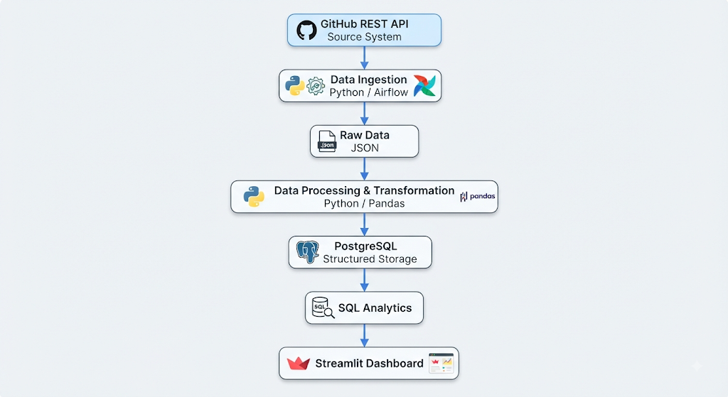
System Architecture - Data Pipeline
Data Flow Process:
1. GitHub API: Fetch repository, commit, issue, and contributor data
2. Extraction: Convert API responses to structured format
3. Cleaning: Handle missing values, remove duplicates, validate data
4. PostgreSQL: Store processed data in normalized tables
5. Analytics: Query and aggregate data for insights
6. Dashboard: Visualize metrics and trends
Notes:
The architecture follows a classic ETL pipeline. First, we extract data from the GitHub API. The raw API response is then parsed and transformed into a consistent format. Next, we perform data cleaning including handling missing values and removing duplicates. The cleaned data is loaded into PostgreSQL where it is organized into normalized tables. Finally, we perform analytics queries and create visualizations through a dashboard.

Slide 6
Thank You
Questions & Discussion
Feel free to ask any questions about the architecture, implementation, or any aspects of the project.

